Slide 1


Grant Proposal
Finlay Campbell | EECID

Slide 2
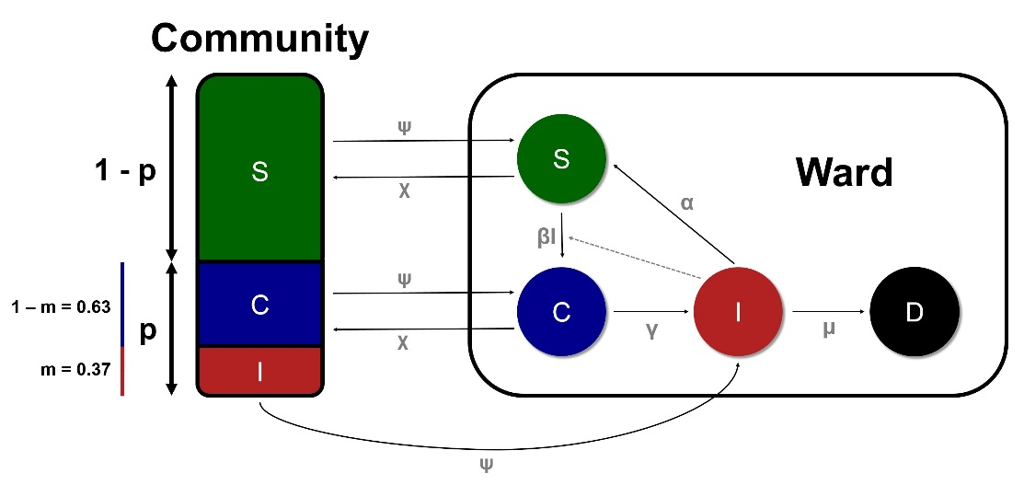
Transmission routes of nosocomial diseases
Nosocomial diseases represent a major global healthcare burden
Community-acquired (CA) and hospital-acquired (HA) infections represent distinct transmission routes with often unknown contributions to overall disease incidence
Hospital infection control policy is poorly targeted and cost ineffective
Determining relative contributions of different transmission routes is of significant interest

Slide 3
#1: Development of R-package for inferring transmission routes of nosocomial diseases
Inferring most likely transmission scenarios in a Bayesian framework
ABC-MCMC using a highly generalised CA-HA transmission and evolution model
Requires minimal epidemiological parameters (incubation, recovery and mortality rate)
Can use both epidemiological and genetic data for inference
Package development
Rewrite existing code from Project 1 with an emphasis on speed and readability
Incorporate genetic data into inference of posterior distributions
Boost computationally expensive processes with C code
Develop user-friendly, robust R-package with useful outputs, including figures
Packages uses
Inform global/national hospital infection control policy for major nosocomial diseases, including Clostridium difficile, MRSA, Streptococcus pneumoniae
Tailored use for individual hospitals or wards

Slide 4
#2: Modelling efficacy of infection control policies in reducing hospital transmission of C. difficile
Construct a high-resolution, spatially explicit hospital model
Recreate observed ward admission and movement behaviour
Integrate a stochastic SEIR transmission model
Simulate impact of various proposed infection control policies
Increased length of patient isolation
Increased sensitivity and specificity of C. difficile diagnosis kits
Reduced or altered antibiotic use
Determine the most effective and cost-effective infection control policies for recommendation to hospital trusts

Slide 5
Me as a Co-I
Computational skills
R programming
R development
Statistical skills
Bayesian statistics
MCMC / ABC-MCMC
Spatiotemporal stochastic modelling
Evolutionary genetics

Slide 6
Expectations of a Co-I
Technical skills
R programming
C programming
Package development
Git/Github
Bayesian statistics
Sufficiently available
Collaboration skills

Slide 7
Questions?

